Slide 1
DOUBLY CIRCULAR LINKED LIST
-Insertion at specific position
DONE BY:
SANJAY KUMAR.S [22MX219]
SHIVSARAN.S [22MX223]

Slide 2
DOUBLY CIRCULAR LINKED LIST:
Circular doubly linked list is a more complexed type of data structure in which a node contain pointers to its previous node as well as the next node.
Circular doubly linked list doesn't contain NULL in any of the node. The last node of the list contains the address of the first node of the list.
The first node of the list also contain address of the last node in its previous pointer.
a circular doubly linked list contains three parts in its structure therefore, it demands more space per node and more expensive basic operations. However, a circular doubly linked list provides easy manipulation of the pointers and the searching becomes twice as efficient.

Slide 3
DOUBLE CIRCULAR LINKED LIST DIAGRAM:
HEAD
PREV
DATA
NEXT
PREV
DATA
NEXT
PREV
DATA
NEXT

Slide 4
INSERTION AT SPECIFIC POSITION DOUBLE CIRCULAR LINKED LIST DIAGRAM:
HEAD
PREV
DATA
NEXT
PREV
DATA
NEXT
PREV
DATA
NEXT
PREV
DATA
NEXT

Slide 5
ALGORITHM FOR INSERTION IN DOUBLY CIRCULAR LINKED LIST:
Initialize stnode = NULL
Get value of new node
If the position where we are asked to insert is < 2or > 1, it is invalid, and we will return.
Else, we will make variable curr and make it point to the head of the list.
Now we will run a for loop using curr to reach to the node at (pos-1)th position:
The for loop will be: for(int i=1;inext;}
After the termination of the above loop, curr will be standing at the (position – 1)th node.
As explained above, we will simply make newnode → next = curr → next and curr → next = newnode.
If the pos was equal to 1, we will make the head point to newnode as newnode will become the first node of the list.

Slide 6
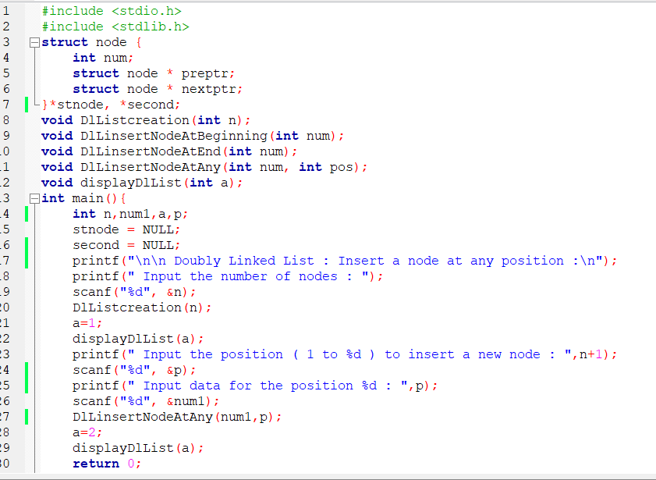
SOURCE CODE

Slide 7
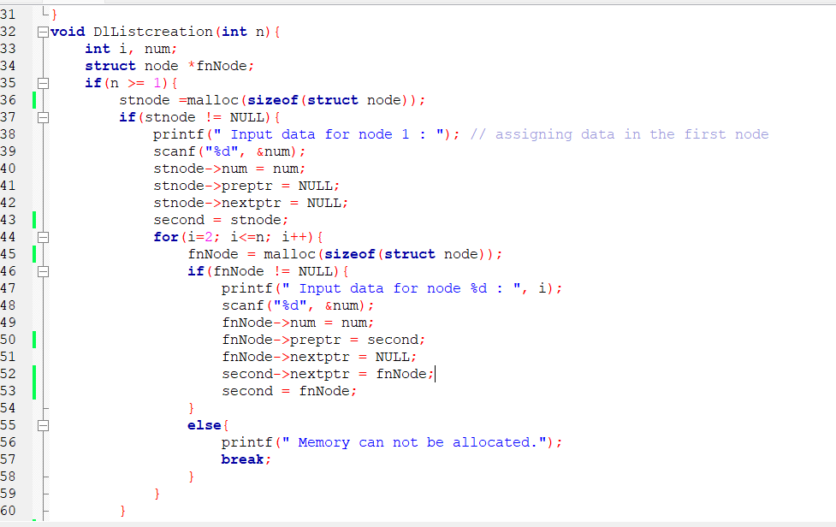

Slide 8
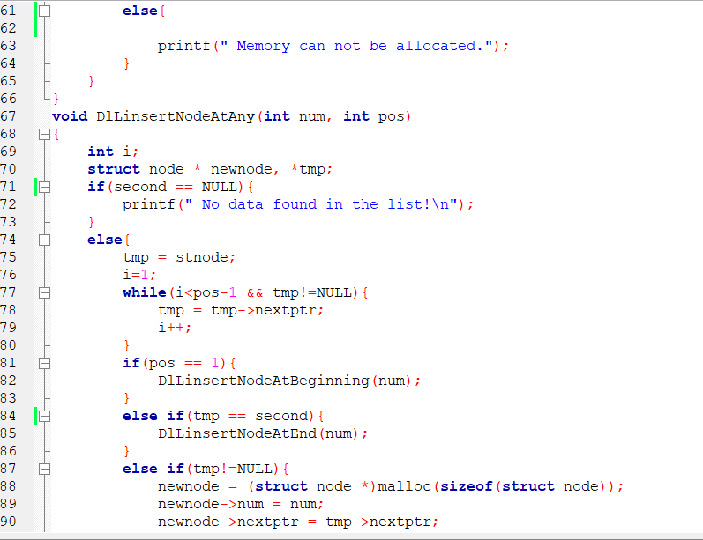

Slide 9
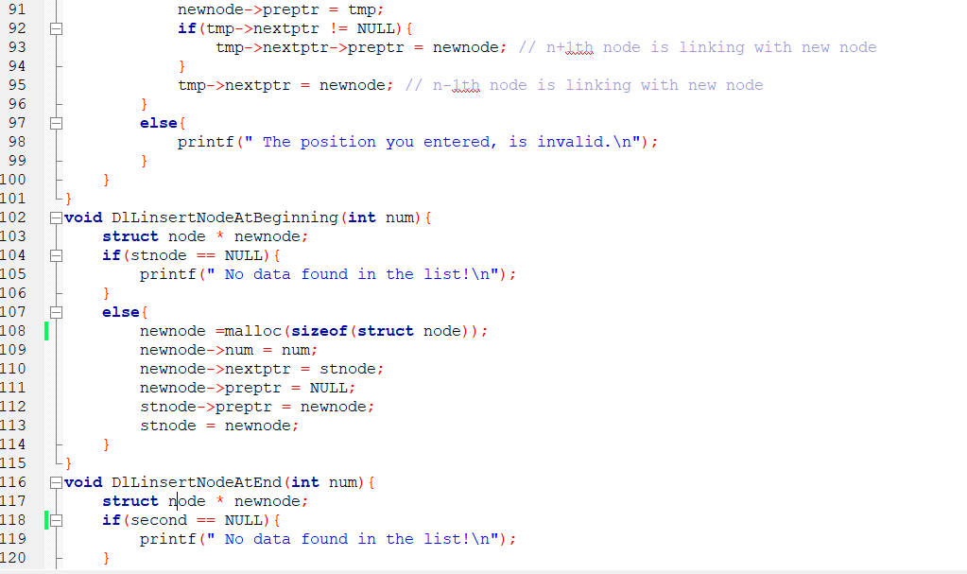

Slide 10
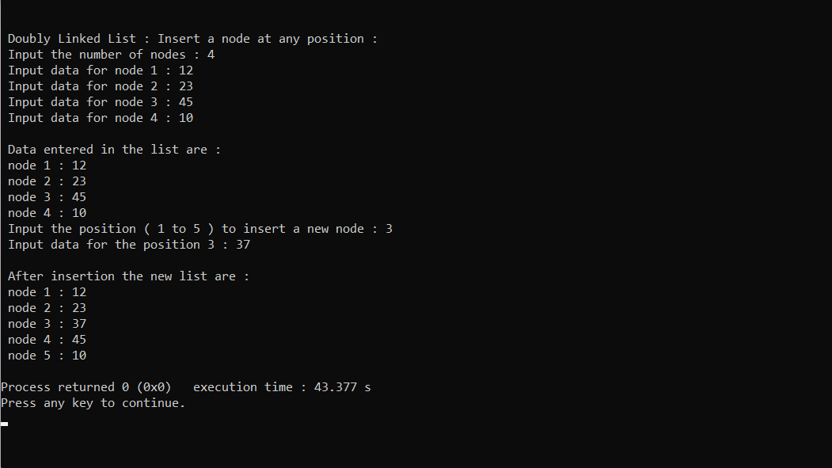
Output

